Slide 1
Mapping ER model to Relational Schema

Slide 2
Constraint
NOT NULL Constraint − Ensures that a column cannot have NULL value.
DEFAULT Constraint − Provides a default value for a column when none is specified.
UNIQUE Constraint − Ensures that all values in a column are different.
PRIMARY Key − Uniquely identifies each row/record in a database table.
FOREIGN Key − Uniquely identifies a row/record in any of the given database table.
CHECK Constraint − The CHECK constraint ensures that all the values in a column satisfies certain conditions.

Slide 3
ER to Relational Schema Mapping
7 Steps

Slide 4
ER to Relational Schema Mapping
Step 1: Mapping of Regular Entity Types
Step 2: Mapping of Weak Entity Types
Step 3: Mapping of Binary 1:1 Relation Types
Step 4: Mapping of Binary 1:N Relationship Types.
Step 5: Mapping of Binary M:N Relationship Types.
Step 6: Mapping of Multi valued attributes.
Step 7: Mapping of N-ary Relationship Types.

Slide 5
Step 1: Mapping of Regular Entity Types

Slide 6
Step 1: Mapping of Regular Entity Types
Create a relation R that includes all simple attributes of E
Each entity became a table
Each single value attribute becomes column
Derived attributes are ignored
Composite attribute represented by components
Key attribute became the primary key of the table

Slide 7
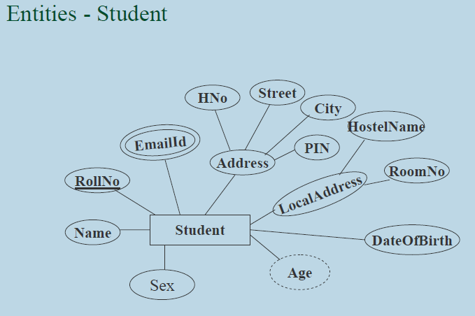
Step 1: Mapping of Regular Entity Types

Slide 8
Step 1: Mapping of Regular Entity Types
Name | RollNo | Hno | Streat | City | PIN | Hostel Name | Room No | Dob | Sex

Slide 9
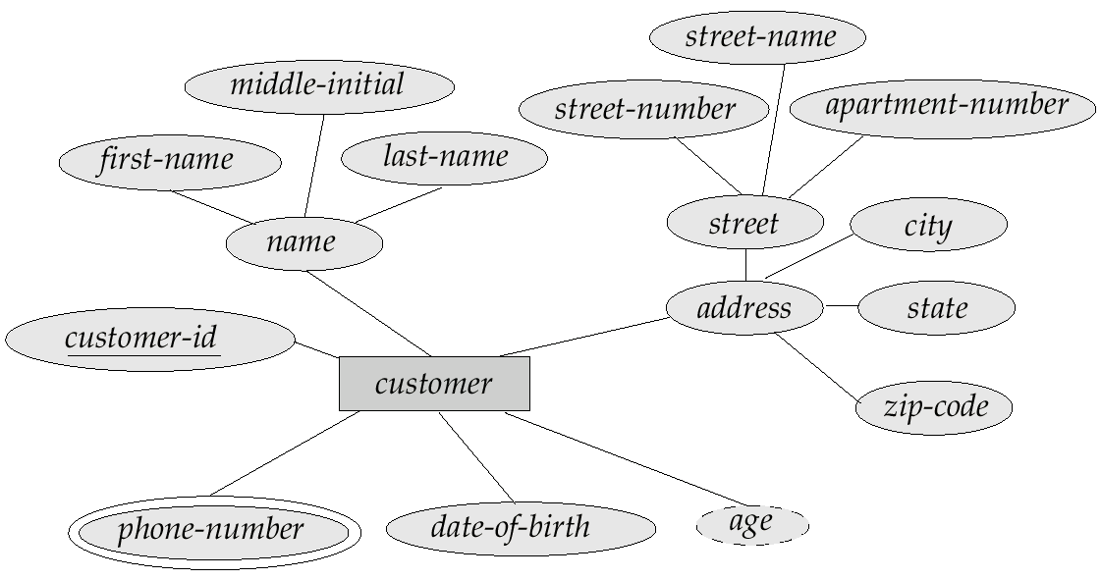

Slide 10
Step 2: Mapping of Weak Entity Types

Slide 11
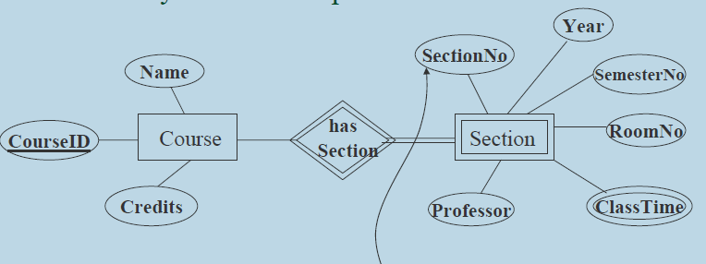
Step 2: Mapping of Weak Entity Types

Slide 12
Step 2: Mapping of Weak Entity Types
Course ID | Course Name | Course Credits
SectionID | CourseID | Section Name | Class No
create table course
(
attributename type primary key,
attributename type
);
create table section
(
attributename type primary key,
attributename type ,
foreign key (loan-number) references course(loan-number)
);

Slide 13
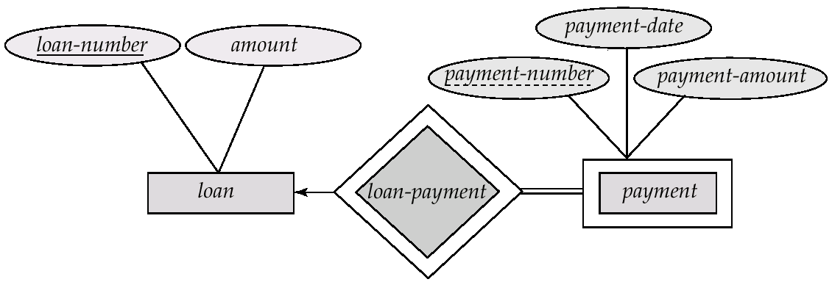
create table tablename
(
attributename type primary key,
attributename type ,
foreign key (loan-number) references Parenttable(loan-number),
);

Slide 14
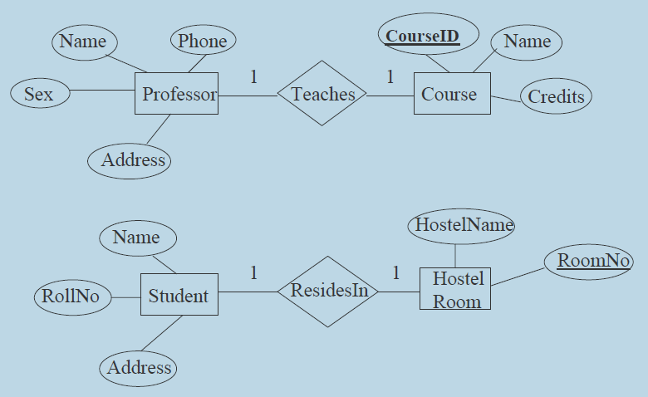
Step 3: Mapping of Binary 1:1 Relation Types

Slide 15
Step 3: Mapping of Binary 1:1 Relation Types
Name | Phone | Age | Sex | Teaches
Course ID | Name | Credit

Slide 16
Step 3: Mapping of Binary 1:1 Relation Types
Employee manages the department
Employee sits on the chair
Chair used by the employee

Slide 17
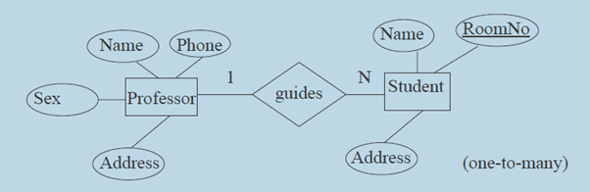
Step 4: Mapping of Binary 1:N Relationship Types
Name | ID | Phone | Address | Sex
Name | Roomno | ID | Address

Slide 18
Step 4: Mapping of Binary 1:N Relationship Types
Teacher teaches many subjects
Student registered many courses

Slide 19
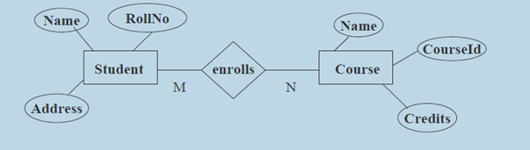
Step 5: Mapping of Binary M:N Relationship Types
Name | Roll No | Address
RollNo | CoutseID
Name | CourseID | Credit

Slide 20
Step 6: Mapping of Multi valued attributes

Slide 21
Step 6: Mapping of Multi valued attributes
Employee
Emp_ID (PK)
Emp_First Name
Emp_Last Name
….
….
Emp-Email_Id
Email_ID
Emp_ID (FK)

Slide 22
Step 7: Mapping of N-ary Relationship Types
Doctor prescribed medicine to a patient

Slide 23
Step 7: Mapping of N-ary Relationship Types
Doctor prescribed medicine to a patient
Doctor
Doctor_ID
Name
…..
Patient
Patient_ID
Patient Name
……
Medicine
Medicine_ID
Medicine Name
…..
Prescription
Doctor_ID
Medicine_ID
Patient_ID
Next Visit

Slide 24
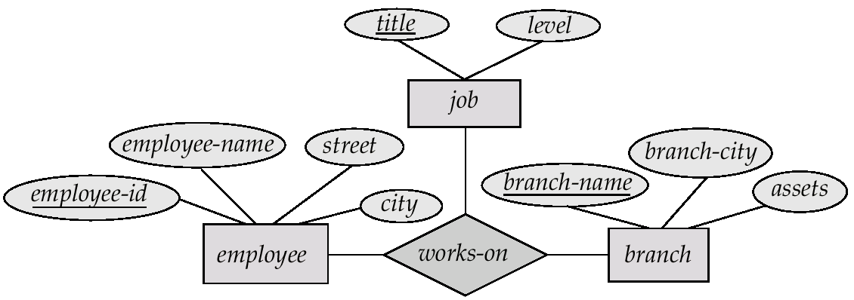

Slide 25
Self referencing Relationship
Employees who are also a couple (1:1)
Employee | Emp ID (PK) | Emp Name | Date of Join | Skill | Spouse ( FK)

Slide 26
Self referencing Relationship
Employee, Manager_of (1:N)
Employee
Emp ID (PK)
Emp Name
Date of Join
Skill
Mgr ID ( FK)

Slide 27
Self referencing Relationship
Employee, Guarantor_of (M:N)
Employee
Emp ID (PK)
Emp Name
Date of Join
Skill
…..
Guarantor
Emp ID (FK)
G ID (FK)

Slide 28
Relational Schema
It Consists of relation name and set of attributes (or) column names.
Each attribute has an associated with domain (set of atomic values, i.e. data type).
Example:
Student { Student name : string
Roll Number : string
Phone Number : integer
Year of admission : integer
Branch : string }

Slide 29
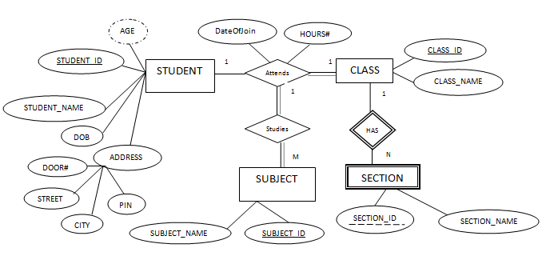

Slide 30
Relational Schema
Key ( Primary Key )
Instances
Examples
Student
Department
Professor
Course
Enrollment
Teaching

